Slide 1

Number System
Lecture 2

Slide 2
What is Data
Data is simply
any numbers, letters or symbols that can be entered into a computer system.
Data values don’t have any meaning unless we put them into context
Information = Data + Context

Slide 3
What is a System
Input
Process
Output
Something feeds into the system (the input)
The system does something with the input (the process)
The process gives a result (the output)

Slide 4

What is a Computer?
A computer is a device that stores and processes information according to a set of instructions.
Process
Data
Information
Store

Slide 5
What is a Computer?
A computer is a device that stores and processes information according to a set of instructions.
Process
Data
Information
I hate this definition….
Store

Slide 6
Activity
Data Name
Name
Height
Date of Birth
Phone No.
Pay Rate
Tax Rate
Data Type
Text
Real
Date
Alphanumeric
Currency
Percentage
Example Data
"Bob Gripper"
1.85
19 May 1980
92-42-11128128
£35.75
15%

Slide 7
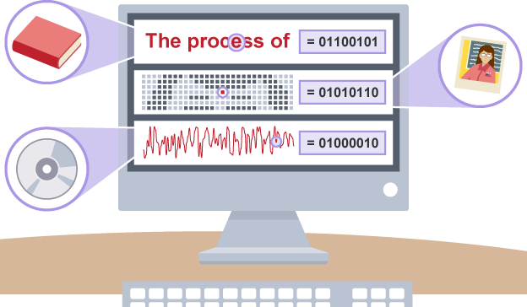
Computers Process Data

Slide 8
Computers Process Data
Computers are used to process all types of information in a broad spectrum fields.
Numeric data consisting of Integers and real numbers are used in programs calculating payroll. We typically perform arithmetic operations on numeric data.
Strings of alphabets and numbers (Alphanumeric Data) are processed in customer record keeping systems.
Multimedia content including images, sound and text are frequently used in a large collection of application areas.
Signals representing various types of information like temperature, pressure, presence or absence of objects etc. are processed by computers in Robotics, IoT, monitoring and control applications.

Slide 9
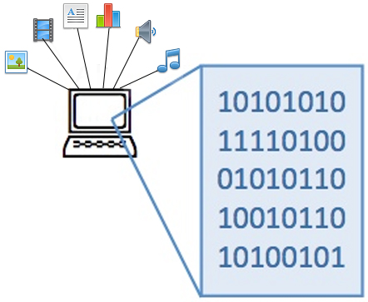
How is Data Actually Stored in Computer
Everything that is stored and processed inside a computer
(all data, information, instructions, files, images, etc.) is stored as Numbers
Digital computers have been made such that all data and instructions(program) for processing must be stored in computers memory before processing.

Slide 10
How to store text and pictures as numbers?
The solution is to use numeric codes:
Different letters in a text document are given different numeric codes
Different pixels (colored dots) in an image are given different numeric codes
Different sounds in a music file are given different numeric codes
Everything is numbers!

Slide 11
What can be represented using a Bit
Computers use binary - the digits 0 and 1 - to store data.
A binary digit, or bit, is the smallest unit of data in computing.
Single Bit can be used to represent two different quantities
ON means TRUE and OFF means FALSE
ON means number 79 and OFF means number -23
ON means 23.5 and OFF means 39.25
ON means RED COLOR and OFF means BLUE COLOR
Most commonly ON means 1 and OFF means 0 and therefore Bit is also known as Binary Digit (Bit)

Slide 12
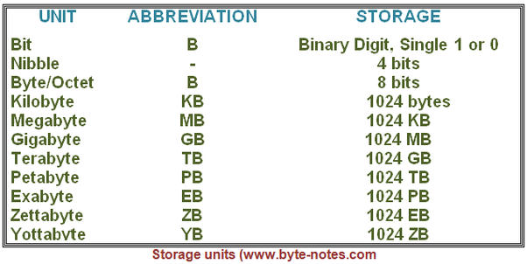
Memory Measuring Units (As viewed by computer scientists)
Bits can be grouped together to make them easier to work with. A group of 8 bits is called a byte.
Most computers can process millions of bits every second. A hard drive's storage capacity is measured in gigabytes or terabytes. RAM is often measured in megabytes or gigabytes.

Slide 13
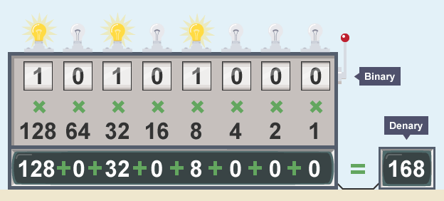
Bytes as Numbers
We can view each byte as a binary number. For Example the following Binary number (10101000) represents the quantity ONE Hundred and SIXTY EIGHT
Can you see the similarity between Binary and Decimal numbers?

Slide 14
Exercise # 1
What Quantities are Represented by the following 8-bit binary numbers.
Bit# | 7 | 6 | 5 | 4 | 3 | 2 | 1 | 0
Place Value | 2⁷ 128 | 2⁶ 64 | 2⁵ 32 | 2⁴ 16 | 2³ 8 | 2² 4 | 2¹ 2 | 2⁰ 1
a. | 0 | 1 | 1 | 1 | 0 | 1 | 0 | 1
b. | 1 | 0 | 1 | 1 | 1 | 0 | 1 | 1
c. | 0 | 1 | 0 | 0 | 0 | 1 | 0 | 0
d. | 1 | 0 | 1 | 0 | 0 | 0 | 0 | 0
e. | 0 | 0 | 0 | 0 | 1 | 1 | 1 | 1
Ans
117
187
68
160
15

Slide 15
Exercise # 2
If a Byte is assumed to represent a number, as described earlier, then what is the range (minimum and maximum values) of numbers that can be stored in a 8-bit Byte?
Min : 0
Max : 128+64+32+16+8+4+2+1 = 255

Slide 16
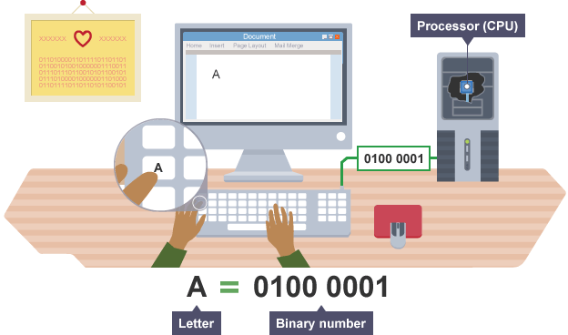
How can we represent a character?
IDEA.
Assign numeric codes to characters and represent each character in a Byte using it’s numeric code.
Can we assign numeric codes of our choice to each character?. What might be a problem with this approach?

Slide 17
How can we represent a character?
IDEA
Create a Standard coding scheme so that information can be easily shared between devices from different vendors.
Standard Codes
ASCII (American Standard Code for Information Interchange)
Unicode
Unicode Transformation Format(UTF) UTF-8, UTF-16
ANSI Character Set

Slide 18
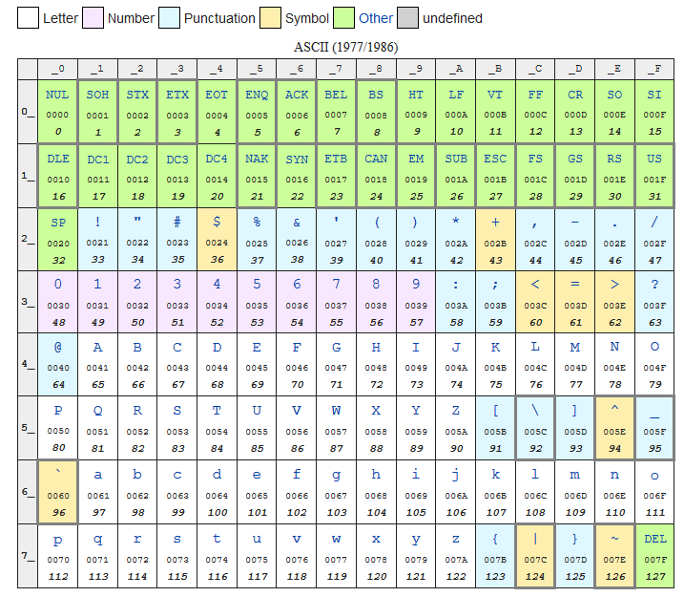
ASCII Character Encoding

Slide 19

Exercise # 4
The following 24 values represents a message consisting of 24 characters stored in RAM.
If the message has been written using 8-Bit Extended ASCII codes then decipher the message
87 104 97 84 32 105 83 32 89 111 117 82 32 70 105 82 83 84 32
78 65 77 69 63
WhaT iS YouR FiRST NAME?

Slide 20
Exercise # 5
Use ASCII encoding to give answer to the question in the previous Exercise?

Slide 21
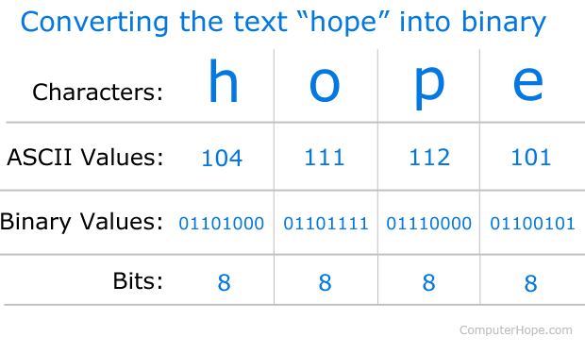
ASCII to Binary 0s and 1s

Slide 22
Representing Non-Negative(Unsigned) Integer Values
Idea No 1.
Each integer is a sequence of characters and hence we can use character encoding to represent each quantity as a sequence of characters.
371 = 51 55 49 ( ASCII)

Slide 23
Exercise # 5
Represent the following integer quantities as sequence of bytes encoded using ASCII characters.
Integer
20456
196
1024
32
100015
ASCII REPRESENTATION
50 48 52 53 54
49 57 54
49 48 50 52
51 50
49 48 48 48 49 53

Slide 24
Representing Non-Negative(Unsigned) Integer Values
Idea No 2.
Integer quantities can be represented using the idea of place value using binary number system. That is each bit has a place value and total value stored is sum of all the place values included in the number.

Slide 25
Representing Non-Negative(Unsigned) Integer Values
Problem
A byte has only eight bits and hence we can not represent quantities bigger than 255 in a byte. For processing integer quantities this is an unacceptably low value.
Solution
Use 2 or more bytes to store an integer quantity

Slide 26
Exercise # 6
Use 2-Bytes to represent each of the following quantity
What is the Maximum unsigned integer value that can be represented using 2 Bytes?
Integer
20456
196
1024
32
100015
2 Byte Representation
01001111 11101000
00000000 11000100
00000100 00000000
00000000 0100000
?
(2¹⁶ -1) = 65535

Slide 27
Exercise # 7
Use 4-Bytes to represent each of the following quantity
What is the Maximum unsigned integer value that can be represented using 4 Bytes?
Integer
20456
196
1024
32
100015
4 Byte Representation
00000000 00000000 01001111 11101000
00000000 00000000 00000000 11000100
00000000 00000000 00000100 00000000
00000000 00000000 00000000 0100000
00000000 00000001 10000110 10101111
(2³² -1) = 4294967295

Slide 28
Representing Signed Integer Values
Problem
How can we represent Signed (Both negative and positive) numbers?
Solution
FIX ONE OF THE BIT FOR REPRESENTING SIGN (Sign-Magnitude method)
(01101101)₂ = +(109)₁₀
(11101101)₂ = -(109)₁₀
(00101011)₂ = +(43)₁₀
(10101011)₂ = -(43)₁₀

Slide 29
Exercise
Represent each of the following quantity in 1-bytes using sign-magnitude method.
What is the Maximum signed integer value that can be represented using 1 Byte?
Integer
65536
-64
64
-110
1 Byte Representation
??
11000000
01000000
10010010
(2⁸⁻¹ -1) = 127
For 2 Bytes (2¹⁶⁻¹ -1) = 32767

Slide 30
Representing Signed Integer Values
Problem
How can we represent Signed (Both negative and positive) numbers?
Use 2’s Complement Representation
1’s complement of a binary number is another binary number obtained by toggling all bits in it, i.e., transforming the 0 bit to 1 and the 1 bit to 0
1's complement of "0111" is "1000"
1's complement of "1100" is "0011"
2’s complement of a binary number is 1 added to the 1’s complement of the binary number.
2's complement of "0111" is "1001" 2's complement of "1100" is "0100"

Slide 31
Exercise
Represent each of the following quantity in 2’s Complement method.
Integer
12
-12
-53
30
-110
1 Byte Representation
00001100
11110100
11001011
00011110
10010010

Slide 32
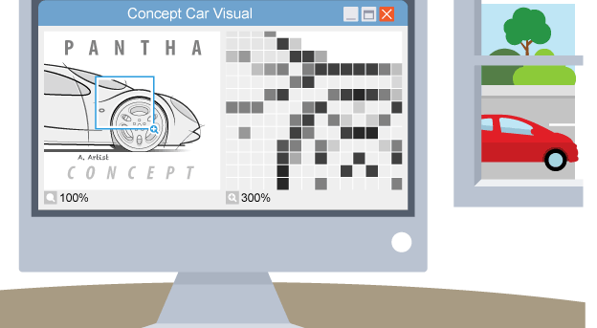
Image Representation

Slide 33
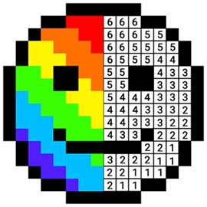
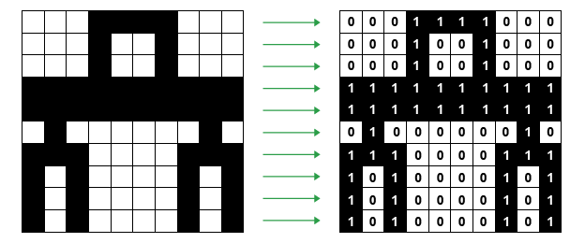
Representing Images in Binary
Graphics on a screen are made up of tiny blocks called pixels.
Each color of an image is stored as a binary number.

Slide 34
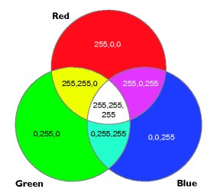
RGB
1 bit per pixel (0 or 1): two possible colors
2 bits per pixel (00 to 11): four possible colors
3 bits per pixel (000 to 111): eight possible colors
4 bits per pixel (0000 – 1111): 16 possible colors
16 Million Distinct Colors
0-255
0-255
0-255

Slide 35
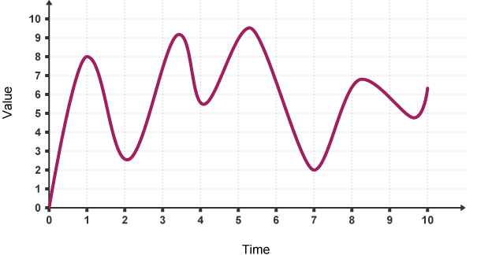
Sound Representation

Slide 36
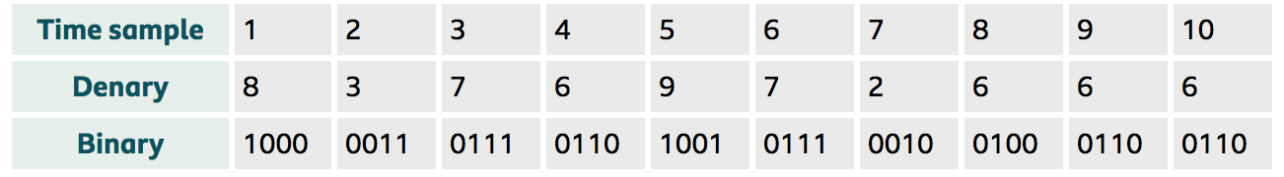
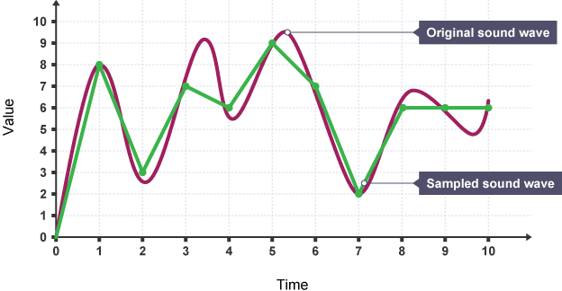
Sound Representation

Slide 37
Number Systems
Decimal, Binary, Hexa-Decimal

Slide 38
Common Number Systems
System | Base | Symbols | Used by humans? | Used in computers?
Decimal | 10 | 0, 1, … 9 | Yes | No
Binary | 2 | 0, 1 | No | Yes
Hexa- decimal | 16 | 0, 1, … 9, A, B, … F | No | No

Slide 39
Conversion Chart
Decimal | Binary | Hex
00 | 0000 | 0
01 | 0001 | 1
02 | 0010 | 2
03 | 0011 | 3
04 | 0100 | 4
05 | 0101 | 5
06 | 0110 | 6
07 | 0111 | 7
08 | 1000 | 8
09 | 1001 | 9
10 | 1010 | A
11 | 1011 | B
12 | 1100 | C
13 | 1101 | D
14 | 1110 | E
15 | 1111 | F

Slide 40
Conversion Among Bases
The possibilities:
Decimal
Binary
Hexadecimal

Slide 41
Quick Example
25₁₀ = 11001₂ = 19₁₆
Base

Slide 42
Conversions
Decimal to Binary
Decimal to Hexadecimal
Binary to Decimal
Binary to Hexadecimal
Hexadecimal to Decimal
Hexadecimal to Binary

Slide 43
Decimal to Binary
Technique
Divide by two, keep track of the remainder
125₁₀ = ?₂
2 125 62 1
2 31 0
2 15 1
2 7 1
2 3 1
2 1 1
2 0 1
125₁₀ = 1111101₂

Slide 44
Conversions
Decimal to Binary
Decimal to Hexadecimal
Binary to Decimal
Binary to Hexadecimal
Hexadecimal to Decimal
Hexadecimal to Binary

Slide 45
Decimal to Hexadecimal
Numbers having base 16
Possible digits are
Technique
Divide by 16
Keep track of the remainder
Decimal | 0 | 1 | 2 | 3 | 4 | 5 | 6 | 7 | 8 | 9 | 10 | 11 | 12 | 13 | 14 | 15
Hexa Decimal | 0 | 1 | 2 | 3 | 4 | 5 | 6 | 7 | 8 | 9 | A | B | C | D | E | F

Slide 46
Example: Decimal to Hexadecimal
1234₁₀ = ?₁₆
16 1234
77 2
16
4 13 = D
16
0 4
1234₁₀ = 4D2₁₆

Slide 47
Conversions
Decimal to Binary
Decimal to Hexadecimal
Binary to Decimal
Binary to Hexadecimal
Hexadecimal to Decimal
Hexadecimal to Binary

Slide 48
Binary to Decimal
Technique
Multiply each bit by 2^{n}, where n is the “weight” of the bit
The weight is the position of the bit, starting from 0 on the right
Add the results

Slide 49
Example: Binary to Decimal
Bit “0”
101011₂ => 1 x 2⁰ = 1 1 x 2¹ = 2 0 x 2² = 0 1 x 2³ = 8 0 x 2⁴ = 0 1 x 2⁵ = 32
43₁₀
2⁵ | 2⁴ | 2³ | 2² | 2¹ | 2⁰
32 | 16 | 8 | 4 | 2 | 1
1 | 0 | 1 | 0 | 1 | 1 | 32+8+2+1 = 43

Slide 50
Conversions
Decimal to Binary
Decimal to Hexadecimal
Binary to Decimal
Binary to Hexadecimal
Hexadecimal to Decimal
Hexadecimal to Binary

Slide 51
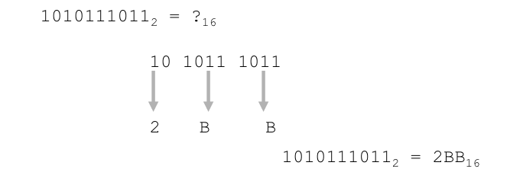
Binary to Hexadecimal
Technique
Group bits in fours, starting on right
Convert to hexadecimal digits

Slide 52
Conversions
Decimal to Binary
Decimal to Hexadecimal
Binary to Decimal
Binary to Hexadecimal
Hexadecimal to Decimal
Hexadecimal to Binary

Slide 53
Hexadecimal to Decimal
Technique
Multiply each bit by 16^{n}, where n is the “weight” of the bit
The weight is the position of the bit, starting from 0 on the right
Add the results

Slide 54
Example
ABC₁₆ = ?₁₀
ABC₁₆ => C x 16⁰ = 12 x 1 = 12 B x 16¹ = 11 x 16 = 176 A x 16² = 10 x 256 = 2560
2748₁₀
16² | 16¹ | 16⁰
256 | 16 | 1
A | B | C
256X10 | 16X11 | 12X1 | 2560+176+12=2748

Slide 55
Conversions
Decimal to Binary
Decimal to Hexadecimal
Binary to Decimal
Binary to Hexadecimal
Hexadecimal to Decimal
Hexadecimal to Binary

Slide 56
Hexadecimal to Binary
Technique
Convert each hexadecimal digit to a 4-bit equivalent binary representation
10AF₁₆ = ?₂
1 0 A F
0001 0000 1010 1111
10AF₁₆ = 0001000010101111₂

Slide 57
Exercise
Decimal | Binary | Hexa- decimal
33
 | 1110101
 |  | 1AF

Slide 58
Answer
Decimal | Binary | Hexa- decimal
33 | 100001 | 21
117 | 1110101 | 75
431 | 110101111 | 1AF

Slide 59
Activity
 | Information in File 1 | Coded Information in File 2
1 | Your NUCES ID | Coded using ASCII Codes (one eight bit code for each ASCII character)
2 | Your Full Name | Name Coded using ASCII Codes (Do remember to code the blank space as well)
3 | Father's Name | Coded using ASCII Codes
4 | Marks in F.Sc. | Coded using 16 bit unsigned code
5 | Your favorite Color from the following list. i) Pure Red, ii) Pure Green iii) Pure Blue | Coded as 24 bit RGB color space using 8-bit for each of the R, G and B components

Slide 60
Activity
Some information has been coded in the ten bytes given above. Decode the information in each of the following cases
Case 1: if these bytes contain characters coded using extended-ASCII or ANSI coding standard
Case 2: if the bytes contain 5 integer values each stored using two byte unsigned integer representation.
Case 3: if the bytes contain 5 integer values each stored using two byte signed integers represented using sign-magnitude method.
10010011 01001101 01000101 01010011 01010011 01000001 01000111 01000101 10010100 00101110

Slide 61
Homework
How to represent Real Numbers?
Fixed point representation.
Floating Point Representation.

Slide 62
Lets Play a Game
https://games.penjee.com/binary-numbers-game/

Slide 63
Recommended
https://www.youtube.com/watch?v=1GSjbWt0c9M
https://www.khanacademy.org/computing/computer-science/how-computers-work2/v/khan-academy-and-codeorg-introducing-how-computers-work
https://www.youtube.com/watch?v=ptzGI9VaZmQ

Slide 64

Thank You

